Slide 1

LONDON RACE PREVIEW
Elite Analysis · July 24 – 25, 2026
USA Triathlon High Performance

Slide 2
Race Week Schedule
London
July 24 – 25, 2026 • ExCeL London, Royal Docks (BST, UTC+1)
Fri • July 24
Sat • July 25
Familiarization & Briefing
WTCS SPRINT RACE DAY
13:30 – 15:30 | Athlete lounge open — ExCeL South Halls
14:00 – 14:30 | Swim course familiarization — Dockside (via Elite Transition)
15:30 – 16:00 | Athlete sign-in for race briefing — South Halls 23/24
16:00 – 16:30 | ★ Mandatory Elite Athletes' race briefing — South Halls 23/24
16:30 – 17:00 | Race pack + accreditation distribution
16:30 – 17:00 | WTCS Team Medical Meeting
08:30 | Bike course familiarization check-in — Elite Transition
09:00 – 09:20 | Bike course familiarization (escorted)
12:30 – 14:00 | Elite Women — Athletes' lounge check-in
13:45 – 14:15 | Elite Women — Transition check-in + swim warm-up
14:23 | Elite Women — Athlete introductions
14:30 | ★ ELITE WOMEN WTCS START
14:45 – 15:45 | Elite Men — Athletes' lounge check-in
15:30 – 16:00 | Elite Men — Transition check-in + swim warm-up
16:08 | Elite Men — Athlete introductions
16:15 | ★ ELITE MEN WTCS START
17:15 | Elite Men awards ceremony
17:30 – 17:40 | Elite Women awards (immediately after men)
Times ExCeL London, Royal Docks (BST, UTC+1). Schedule confirmed from World Triathlon race-info page / athlete guide;

Slide 3
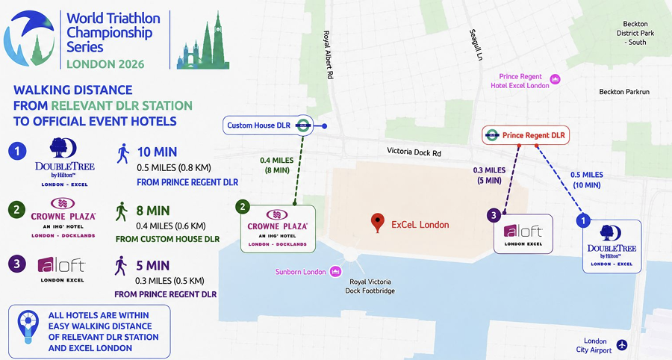
Key Course Differentiators
London
LONDON
COURSE AT A GLANCE
WTCS London moves to the ExCeL in the Royal Docksm, a sprint-distance, stadium-style race with an afternoon start (Women 14:30, Men 16:15). The swim is a single 750 m loop in the enclosed Royal Victoria Dock, followed by a dead-flat, fast 20.64 km bike (7 short out-and-back laps on Royal Albert Way) and a 4.92 km run that weaves through the ExCeL venue hall on each of 3 laps. Cool UK-summer conditions and a flat, fast layout mean this race should be ripping from the start.
Swim:
750 m – 1 lap
Bike:
20.64 km – 7 laps × 2.64 km
Run:
4.92 km – 3 laps × 1.64 km
Format:
Sprint Triathlon (WTCS)
QUICK LINKS
COURSE FEATURES
Current Race Info:
Race Info | 2026 WTCS London
• 750 m single-loop swim in the enclosed Royal Victoria Dock. Pontoon start. Water temperature ranges from 18-21 C, thus athletes/coaches need to get accurate sample in the lead up to race for wetsuit ruling.
• Flat & fast crit style bike course: 7 × 2.64 km out-and-back laps (20.64 km.
• 4.92 km run, 3 laps partly indoors through the ExCeL hall. Short distance, flat terrain, and potential for cool conditions should enable fast runners to leverage their run speed.
• Afternoon start (W 14:30 / M 16:15).

Slide 4
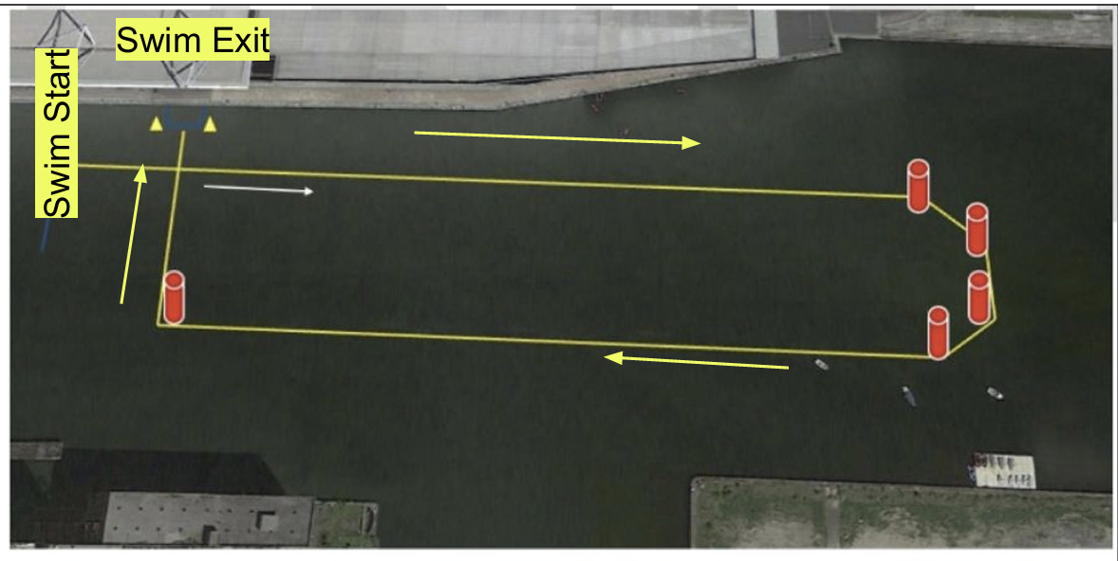
Swim Course Profile
London
750 m • single lap
Enclosed freshwater dock — no current, urban dock water
Distance
Layout
Start
750 m
Royal Victoria Dock
Pontoon start
[Drop swim course map here] Save the organiser map as: ppt files/support/london_swim_course.png It will be embedded automatically on the next run.
Water Temp
Wetsuit
Lap Count
18.0–21.0 °C (expected)
Borderline
1
Tactical Notes
• Single 750 m clockwise loop in the Royal Victoria Dock, off the ExCeL dockside. Enclosed dock should result in flat water conditions.
• Pontoon start with a 315 m leg to the first buoy. Hard start to ensure good positioning at the turnaround.
Source: 2026 WTCS London Elite Athlete's Guide (Royal Docks, ExCeL)
• Afternoon starts (W 14:30 / M 16:15). Water will be at its warmest of the day. Potential to be non wetsuit. Get an idea of water temp in afternoon prior to race.
Not in race brief: Confirmed race-day water temperature (published at the pre-race reading)

Slide 5
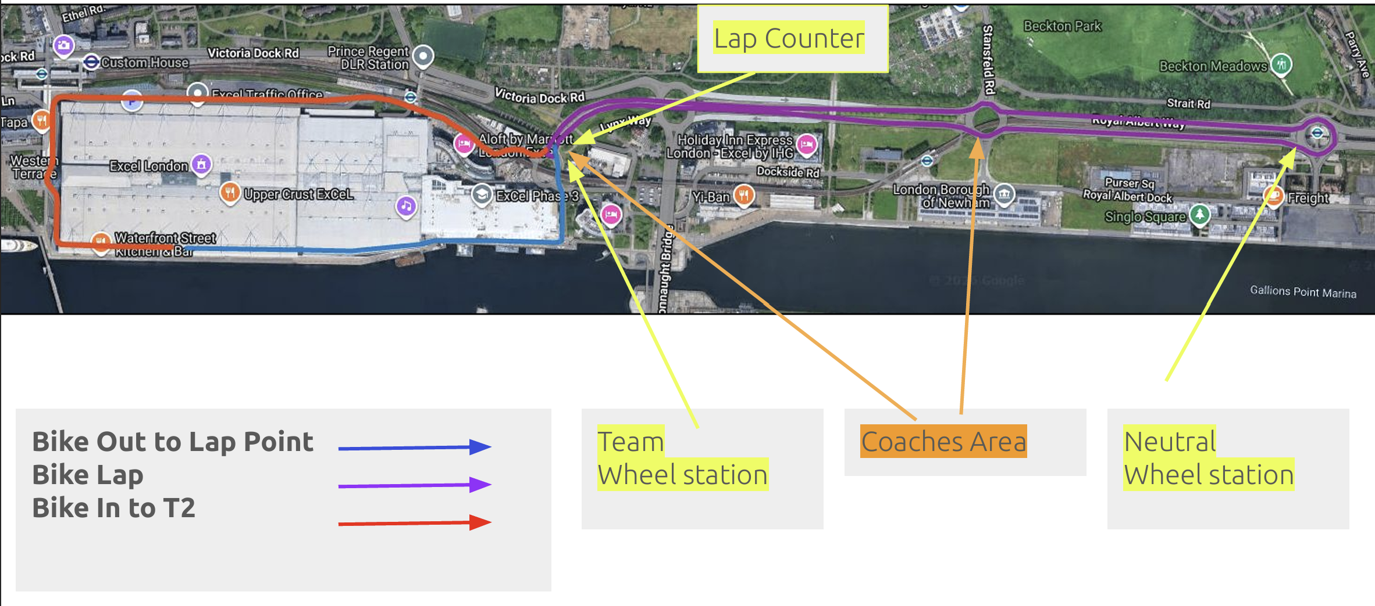
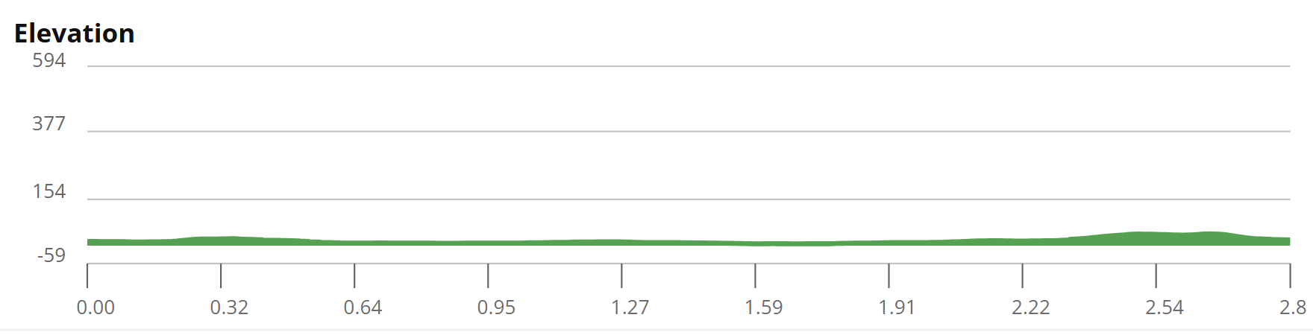
Bike Course Profile
London
20.64 km • 7 × 2.64 km loops
Closed private roads + national highways (contraflow) — Royal Albert Way
[Drop course map here] Save the organiser course map as: ppt files/support/london_bike_course.png It will be embedded automatically on the next run.
Elevation / Lap
Total Climb
Avg Grade
Flat (< 10 ft / lap)
~60 ft (small incline on final section)
0%
Max Climb Grade
Wind
Loops
NA
Potential for exposure along dock
7 × 2.64 km
Tactical Implications
• Flat and fast: 7 × 2.64 km out-and-back laps on Royal Albert Way (+0.75 km bike-out, +1.23 km bike-in) = 20.64 km. Dead flat dockside course favors the ability to put down raw power.
Source: 2026 WTCS London Elite Athlete's Guide (ExCeL, Royal Docks)
• Out-and-back on a wide highway. Strong likelihood for big lead packs to form. Positioning into the U-turns is key
• Course uses private roads/highways only open during official familiarization (Sat 09:00–09:20) — no race-direction preview otherwise

Slide 6
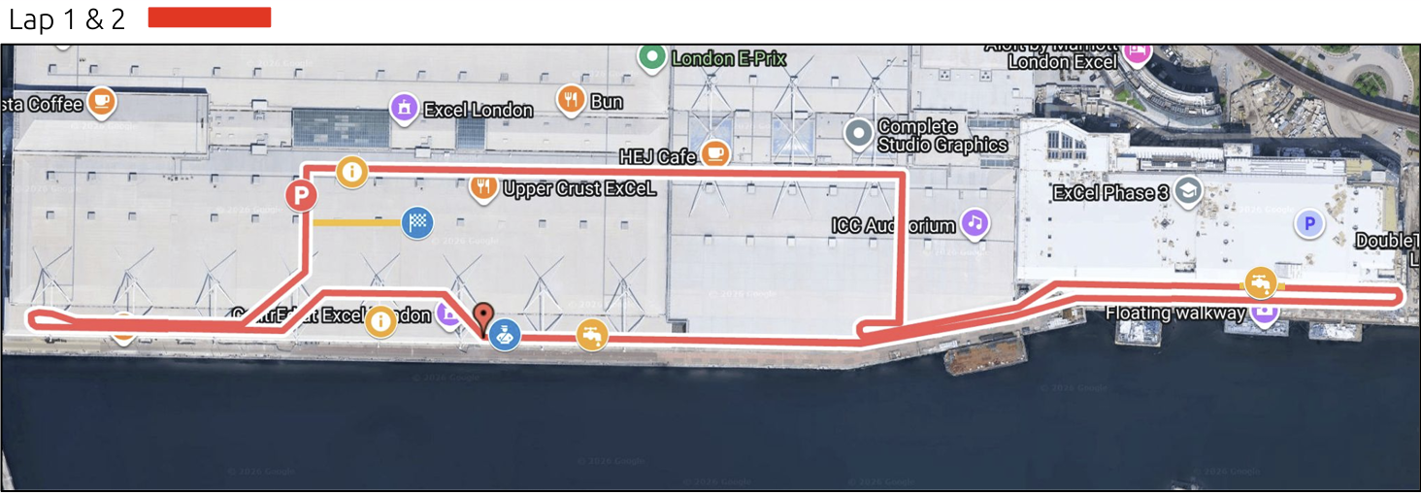
Run Course Profile
London
4.92 km • 3 × 1.6 km
Mixed indoor/outdoor — through the ExCeL venue hub each lap
Distance
Lap Structure
Total Climb
4.92 km
3 × 1.6 km
Not published
[Drop run course map here] Save the organiser map as: ppt files/support/london_run_course.png It will be embedded automatically on the next run.
Avg Grade
Max ▲ / ▼
Heat Risk
—
Not published
LOW
Tactical Notes
• 3 anti-clockwise laps (1.76 + 1.76 + 1.34 km = 4.92 km) routed through the main ExCeL venue hub each lap.
• Flat and partly indoors course should make for fast conditions. Same venue that the T100 utilized should make for a loud and atmospheric environment.
Source: 2026 WTCS London Elite Athlete's Guide (ExCeL, Royal Docks)
• Three laps is atypical for sprint race. Lap counter will be at transition exit and make sure to note the finish chute is a left-hand turn on lap 3 (final 62 m)
Not in race brief: Elevation profile (course is flat — no published grade data). Can’t build on Garmin Connect due to building inclosure.

Slide 7
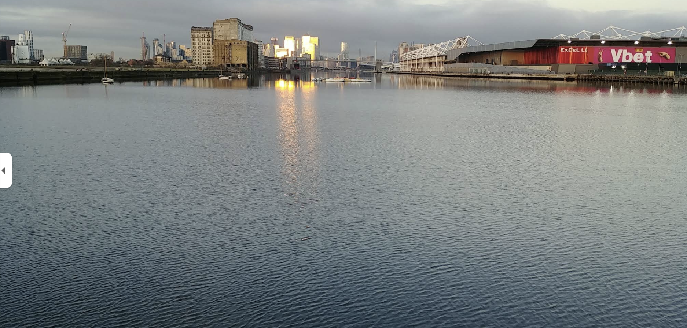
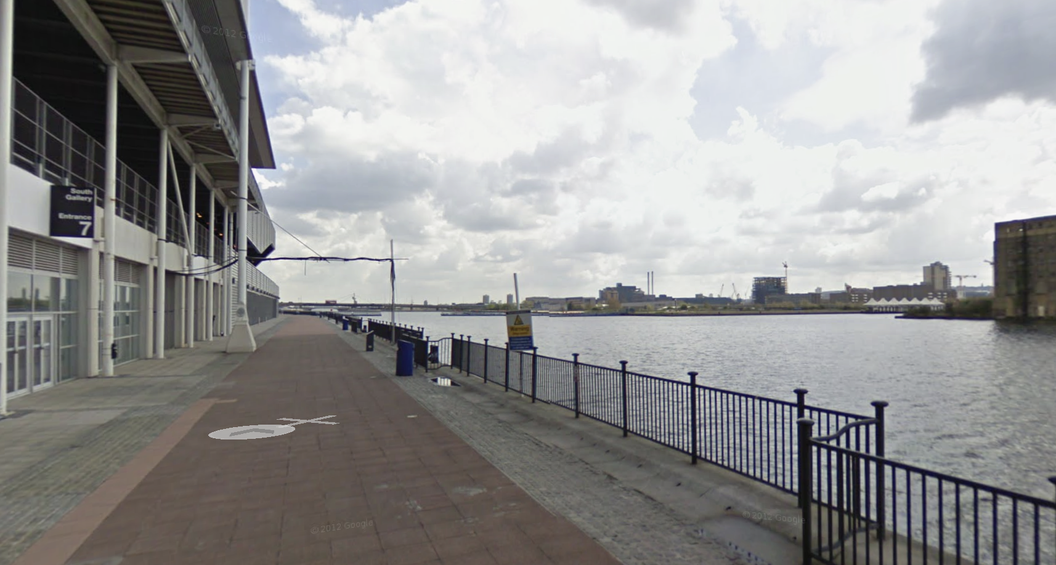
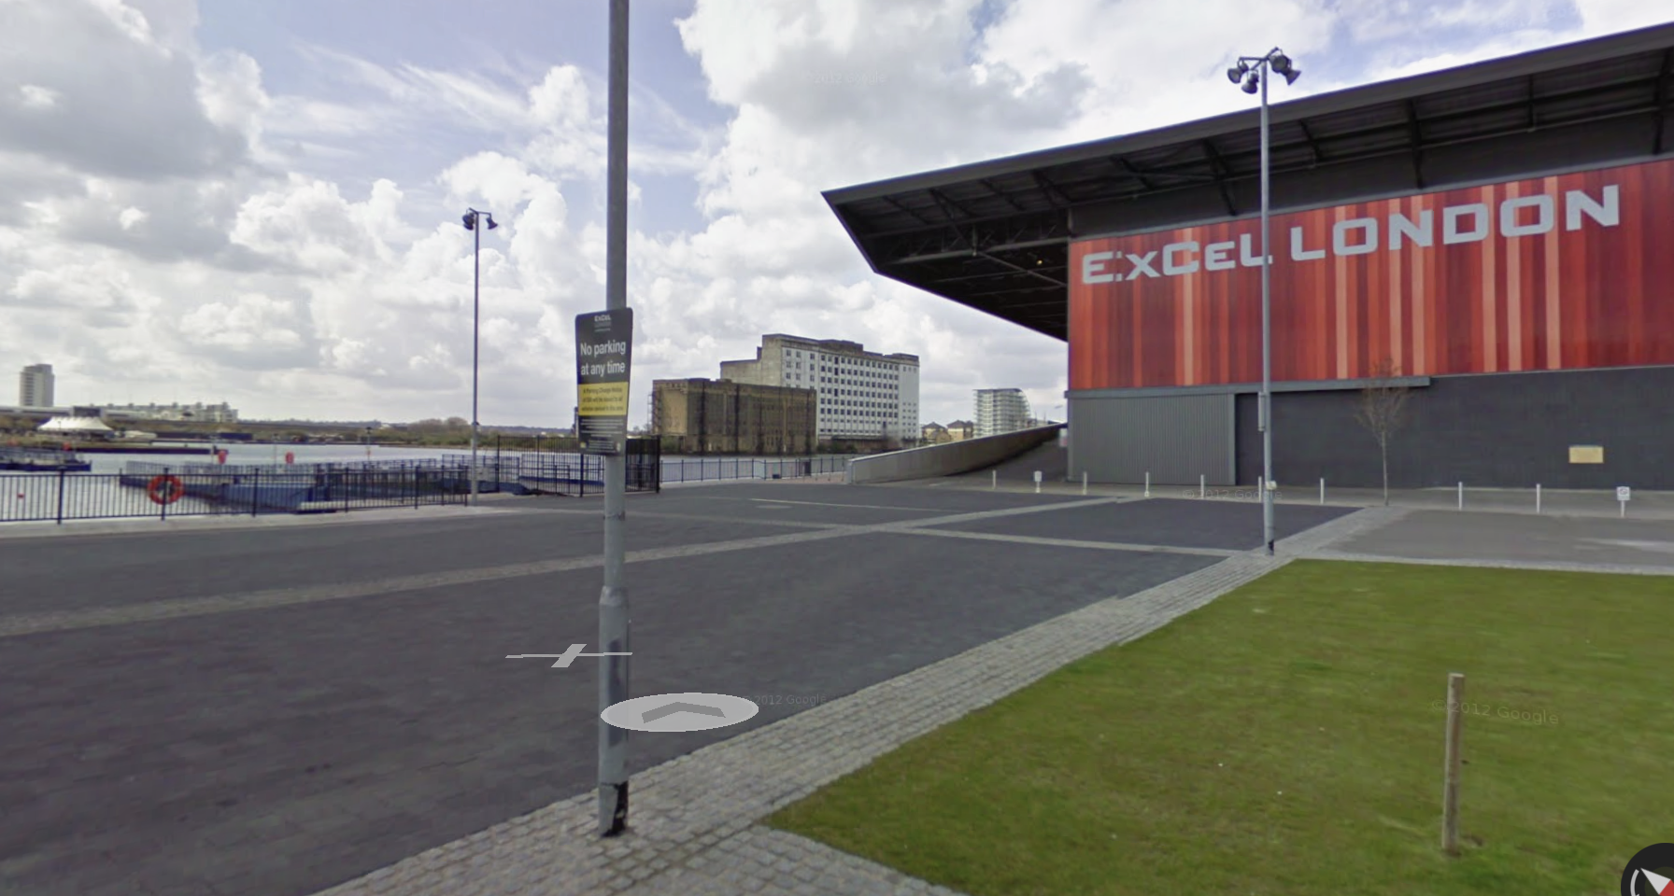
Course Photos
London
Swim Area
Exit From Building onto Bike Course
First Left Turn off the side alley bike course

Slide 8
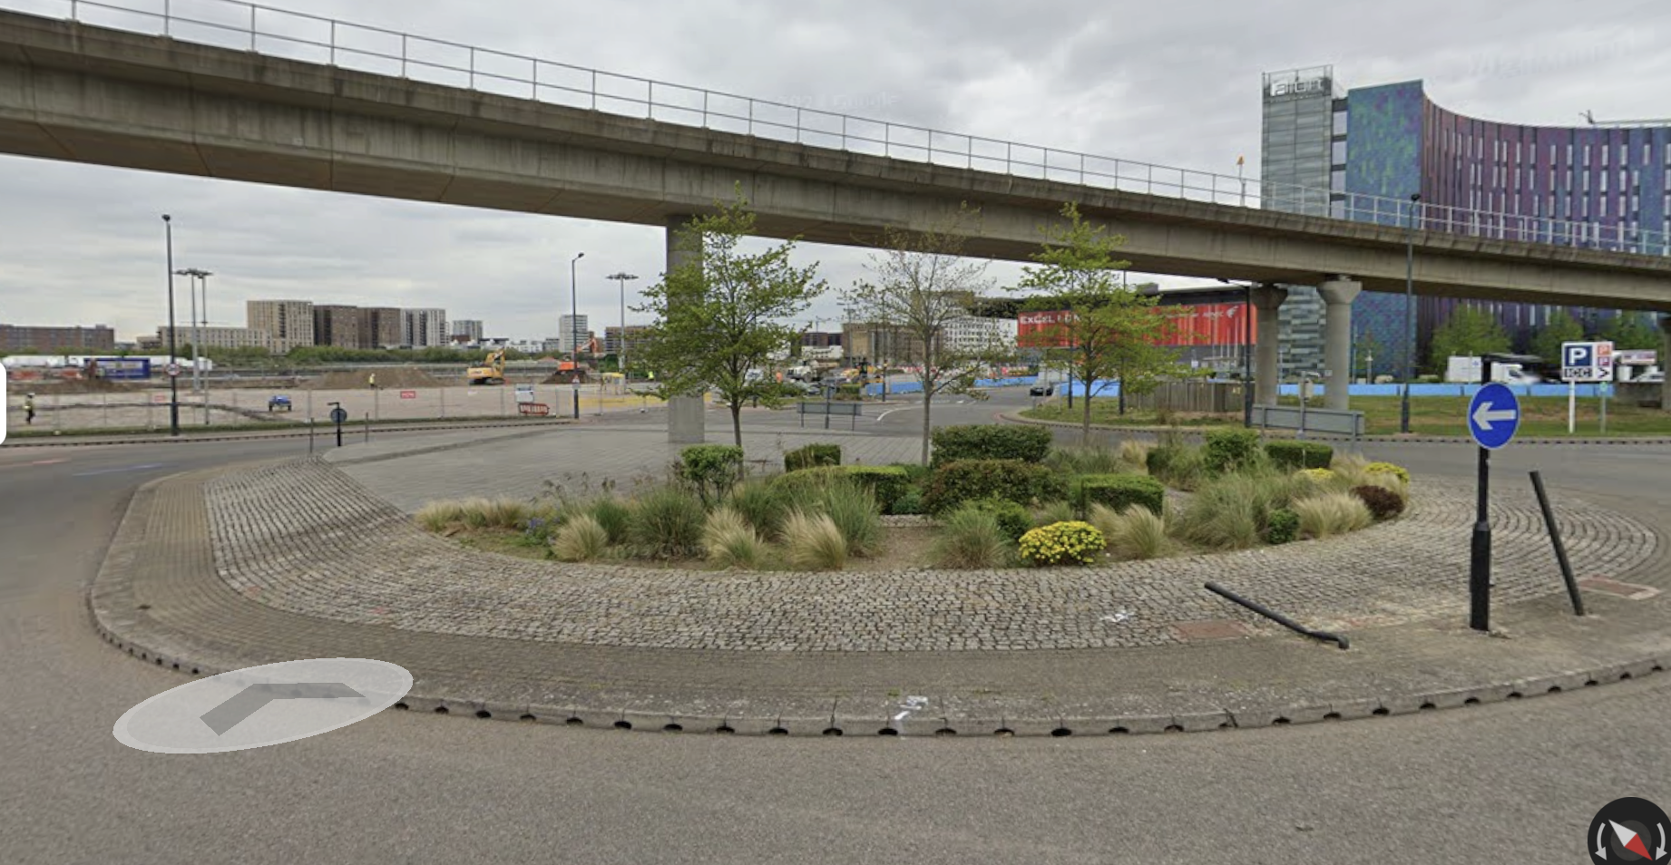
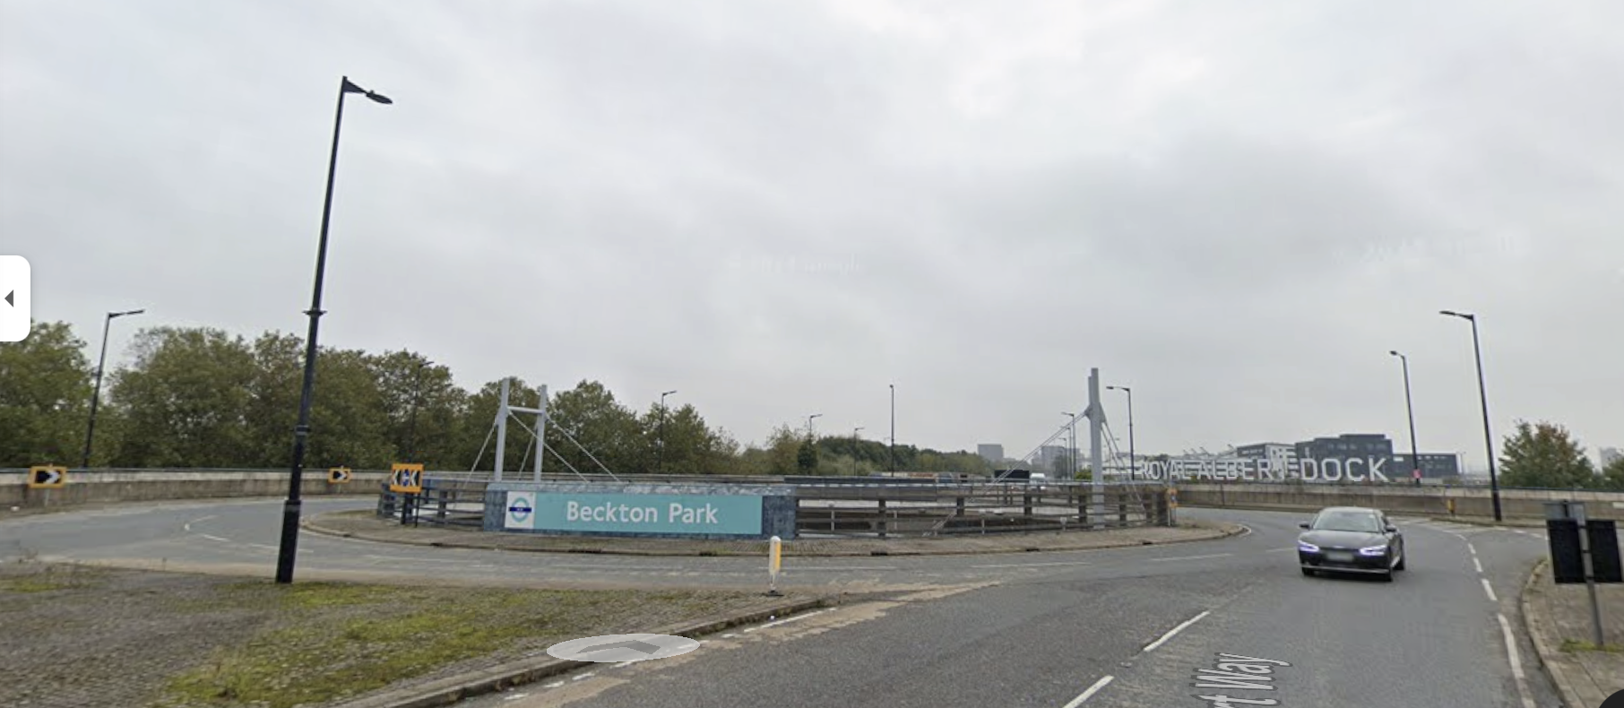
Course Photos
London
Far Turnaround on Bike Course
Beginning of Bike Climb
First Roundabout on Bike Course
Halfway / End of Bike Climb

Slide 9
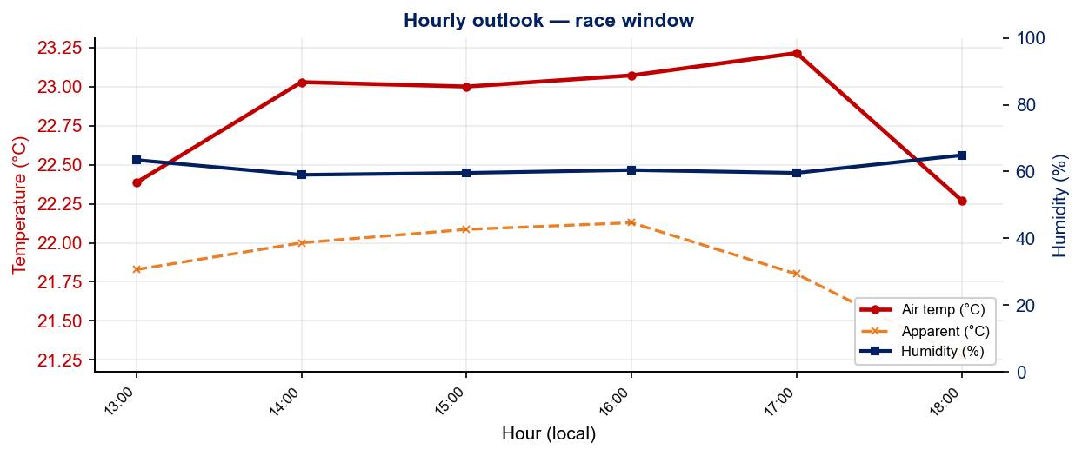
Race-Day Weather Outlook
London
2026-07-25 • Historical climatology — same calendar day, 7-year mean
Elite Women — 14:30
Temperature
Apparent / Heat
Humidity
23.0 °C
22.1 °C
60%
Wind
UV peak
Heat Stress
17.8 km/h
—
LOW
Elite Men — 16:15
Temperature
Apparent / Heat
Humidity
22.9 °C
21.7 °C
62%
Wind
UV peak
Heat Stress
18.0 km/h
—
LOW
Hydration & Cooling Cues
• Cool to mild outlook. Standard fluid plan, no special pre-cooling required
• Notable wind (19 km/h). Drafting protection key on exposed coastal bike sections.
Data source: Open-Meteo.

Slide 10
Travel & Arrival Load
Denver, CO → London race week
Core travel read
Denver → London is a single long-haul leg — British Airways runs a DEN → LHR nonstop, plus many one-stop options via ORD / EWR / JFK into LHR or LGW. Overnight eastbound, ~9 h flight + 7 h time-zone shift (MDT → BST). From Heathrow, the ExCeL is ~1 h by taxi or the Elizabeth Line. No LOC airport shuttle. Self-arrange with 60 pound reimbursement.
Primary route
Flight time
Time zones
Airport → Venue
Transfer Distance
DEN → LHR
~9 h
+7 h
LHR → ExCeL
~40 km / 60–75 min
BA nonstop / 1-stop
Overnight eastbound
London ahead of Denver
Elizabeth Line + DLR
Custom House stn = venue
Host Hotel / Accommodation Read
Food / Grocery Options Near Venue
• Venue is the ExCeL London (Royal Docks). Athlete access via Door S5, South Halls.
• Grocery: Waitrose / Tesco / Sainsbury's around Canary Wharf (2 DLR stops) for staples, water, and room food.
• On-site / adjacent hotels: Aloft, Novotel, Sunborn Yacht, CopperBox and Premier Inn ExCeL. All walkable to transition.
• On-site: the ExCeL boulevard has cafés and chains, but options thin outside event hours.
• Custom House (Elizabeth Line + DLR) is the venue tube station.
• UK entry: US athletes need an ETA (Electronic Travel Authorisation) before travel. Apply in advance.
• Water is tap-safe throughout London.

Slide 11

Environmental Risk Profile
London
RACE-DAY WEATHER (14:00–18:00 local)
HEALTH & WATER QUALITY RISK FACTORS
Year | Date | Air Temp | Humidity | Wind km/h | Precip mm
2024 | Jul 27 | 24.2 | 46% | 11 | 0.0
2025 | Apr 05 | 13.3 | 35% | 14 | 0.0
2025 | Aug 09 | 20.7 | 35% | 14 | 0.0
AIR QUALTY (Open-Meteo archive)
Year | PM2.5 | EU AQI | UV Index | Risk
2024 | 4.2 | 29 | 1.4 | Fair
2025 | 7.7 | 34 | 1.9 | Fair
2025 | 4.2 | 32 | 2.8 | Fair
Weather and AQ data: Open-Meteo historical archive (archive-api.open-meteo.com). EU AQI: Good ≤20, Fair ≤40, Moderate ≤60, Poor ≤80, Very Poor >80.

Slide 12
Who to Watch — London Race Week
ELITE MEN
ELITE WOMEN
Top 10 Ranked on Startlist
Top 10 Ranked on Startlist
Rank | Athlete | Points
1 | Vasco Vilaca | 6,866
2 | Miguel Hidalgo | 6,808
3 | Matthew Hauser | 6,424
4 | Henry Graf | 6,009
6 | Csongor Lehmann | 4,789
7 | Luke Willian | 4,496
9 | Ricardo Batista | 4,280
10 | Charles Paquet | 4,128
11 | Oliver Conway | 3,615
12 | Tom Richard | 3,482
Rank | Athlete | Points
1 | Beth Potter | 7,347
2 | Lisa Tertsch | 7,136
3 | Leonie Periault | 6,468
4 | Jeanne Lehair | 6,306
5 | Taylor Spivey | 5,256
6 | Jolien Vermeylen | 5,095
7 | Emma Lombardi | 4,930
8 | Cassandre Beaugrand | 4,725
9 | Diana Isakova | 4,710
10 | Bianca Seregni | 4,659
Rankings = current World Triathlon rankings snapshot; startlist intersect uses program_entries when available.

Slide 13
Top Swim Threats
London
Ranked by Lead Pack % (within 15 s of swim leader) • EWMA swim split shown per distance • WTCS / World Cup / Continental, last 4 yrs
ELITE MEN
ELITE WOMEN
# | Athlete | Lead % | EWMA Spr | EWMA Std ▸ | Spr/Std
1 | Alessio Crociani | 100% | 8:39 | 17:19 | 17/4
2 | Michael Gar | 100% | 8:49 | 17:28 | 6/2
3 | Márk Dévay | 97% | 8:50 | 17:12 | 10/24
4 | Miguel Tiago Silva | 95% | 8:58 | 17:31 | 8/14
5 | Matthew Hauser | 95% | 8:29 | 17:22 | 8/12
6 | Brayden Mercer | 95% | 8:53 | 17:50 | 13/7
7 | Max Stapley | 86% | 8:50 | 17:38 | 10/11
8 | Csongor Lehmann | 83% | 8:38 | 17:27 | 7/16
9 | Henry Graf | 82% | 8:56 | 17:31 | 12/5
10 | Chase McQueen | 79% | 9:04 | 18:02 | 10/14
11 | Alberto Gonzalez Garcia | 77% | 8:23 | 18:08 | 18/8
12 | Diego Moya | 77% | 8:32 | 17:46 | 19/11
13 | Tom Lerno | 72% | 8:55 | 17:35 | 16/2
14 | Jules Rethoret | 69% | 8:48 | 17:53 | 9/4
# | Athlete | Lead % | EWMA Spr | EWMA Std ▸ | Spr/Std
1 | Vittoria Lopes | 100% | 10:10 | 18:56 | 8/9
2 | Tilly Anema | 100% | 9:22 | 18:57 | 5/6
3 | Bianca Seregni | 93% | 9:02 | 19:03 | 8/20
4 | Cassandre Beaugrand | 87% | 9:50 | 19:42 | 5/10
5 | Sophie Evans | 80% | 9:45 | 19:22 | 4/6
6 | Olivia Mathias | 79% | 9:45 | 18:58 | 14/10
7 | Jolien Vermeylen | 74% | 9:07 | 18:41 | 19/19
8 | Taylor Knibb | 71% | 8:52 | 19:00 | 1/6
9 | Sophia Howell | 71% | 9:49 | 19:46 | 27/8
10 | Taylor Spivey | 70% | 9:44 | 19:14 | 6/14
11 | Sian Rainsley | 68% | 9:49 | 19:15 | 11/11
12 | Kate Waugh | 65% | 9:49 | 20:20 | 9/11
13 | Emma Lombardi | 61% | 10:01 | 19:54 | 7/11
14 | Eva Goodisson | 59% | 10:25 | 19:33 | 18/11

Slide 14
USA World Rankings Snapshot
London
As of 2026-07-13 • World Triathlon Rankings • Heading into London • Race tier: WTCS
Max Points Available at this Race
Win
Podium
Top 5
Top 10
Top 15
Top 20
1,000 pts
855 pts
732 pts
495 pts
335 pts
227 pts
ELITE MEN
ELITE WOMEN
Rank | Athlete | Points | Curr | Prev
19 | John Reed | 2,898 | 6 | 6
28 | Reese Vannerson | 2,628 | 6 | 6
51 | Braxton Legg | 2,109 | 6 | 6
54 | Morgan Pearson | 2,093 | 5 | 4
62 | Seth Rider | 1,927 | 6 | 5
65 | Sullivan Middaugh | 1,901 | 6 | 6
68 | Keller Norland | 1,795 | 6 | 6
73 | Blake Bullard | 1,761 | 6 | 6
81 | Chase McQueen | 1,708 | 6 | 6
107 | Darr Smith | 1,452 | 6 | 6
111 | Zach Leachman | 1,433 | 6 | —
134 | Porter Middaugh | 1,223 | 6 | 5
166 | Carter Stuhlmacher | 1,038 | 6 | 3
279 | Cole Jamieson | 600 | 4 | 2
337 | Matthew McGoey | 451 | 5 | 6
Rank | Athlete | Points | Curr | Prev
5 | Taylor Spivey | 5,256 | 6 | 4
23 | Gina Sereno | 2,747 | 5 | 6
27 | Gwen Jorgensen | 2,639 | 5 | 6
35 | Danielle Orie | 2,432 | 6 | 6
53 | Erika Ackerlund | 1,981 | 5 | 6
56 | Naomi Ruff | 1,928 | 6 | 6
59 | Kelly Wetteland | 1,843 | 6 | 3
83 | Kirsten Kasper | 1,551 | 5 | 2
84 | Eleanor Beveridge | 1,544 | 6 | 6
90 | Joy Gill | 1,514 | 6 | 4
104 | Michelle Magnani | 1,319 | 6 | 6
107 | Rachel Werking | 1,302 | 6 | 2
146 | Ellison Wolfe | 1,058 | 6 | 3
150 | Katie McCune | 1,042 | 6 | 1
158 | Taylor Knibb | 1,003 | 2 | 1

Slide 15
Olympic Qualification Pace
London
Paris 2024 OQR cutoff (30th): 3,626.69 pts ÷ 12-event cap = 302 pts / event on pace
An athlete who averages ~302 pts per event across their best 12 events is on pace to clear the LA 2028 qualifying threshold.
FINISH POSITION AT EACH TIER THAT HITS 302-PT PACE
Tier | Win pts | Last on-pace pos | First off-pace pos (pts) | Verdict
World Championship Series | 1000 | #16 | #17 (287 pts) | Top 16
World Cup | 500 | #7 | #8 (290 pts) | Top 7
USA MEN
USA WOMEN
Rk | Athlete | Total | Races | On | Off | Pace | Proj @12
18 | Reese Vannerson | 980 | 2 | 2 | 0 | 490 | 5,884
22 | Seth Rider | 845 | 3 | 2 | 1 | 281 | 3,381
27 | Chase McQueen | 764 | 3 | 1 | 2 | 254 | 3,059
32 | Sullivan Middaugh | 677 | 2 | 1 | 1 | 338 | 4,063
38 | John Reed | 599 | 2 | 1 | 1 | 299 | 3,598
43 | Braxton Legg | 564 | 2 | 1 | 1 | 282 | 3,384
46 | Keller Norland | 519 | 1 | 1 | 0 | 519 | 6,234
50 | Blake Bullard | 436 | 2 | 0 | 2 | 218 | 2,621
82 | Zach Leachman | 212 | 1 | 0 | 1 | 212 | 2,545
93 | Cole Jamieson | 169 | 1 | 0 | 1 | 169 | 2,038
110 | Porter Middaugh | 115 | 1 | 0 | 1 | 115 | 1,380
Rk | Athlete | Total | Races | On | Off | Pace | Proj @12
11 | Taylor Spivey | 1,370 | 2 | 2 | 0 | 685 | 8,225
14 | Danielle Orie | 1,146 | 4 | 2 | 2 | 286 | 3,439
18 | Gina Sereno | 991 | 3 | 1 | 2 | 330 | 3,966
20 | Taylor Knibb | 921 | 2 | 2 | 0 | 460 | 5,526
38 | Eleanor Beveridge | 519 | 2 | 0 | 2 | 259 | 3,114
44 | Gwen Jorgensen | 495 | 1 | 1 | 0 | 495 | 5,949
47 | Kelly Wetteland | 462 | 1 | 1 | 0 | 462 | 5,550
48 | Naomi Ruff | 460 | 1 | 1 | 0 | 460 | 5,526
91 | Rachel Werking | 181 | 1 | 0 | 1 | 181 | 2,178
93 | Erika Ackerlund | 179 | 1 | 0 | 1 | 179 | 2,159
96 | Joy Gill | 167 | 1 | 0 | 1 | 167 | 2,014
On = events scoring ≥ pace. Off = events < pace. Pace = total breakdown pts ÷ events raced. Proj @12 = current total + (avg pts × remaining events to cap); green if ≥ Paris cutoff. Cutoff estimate: Paris 2024 = 3,627 pts / 12 events = 302 pts/event. Tier positions use a geometric 0.925 points model. Source: World Triathlon rankings database.

